Slide 1
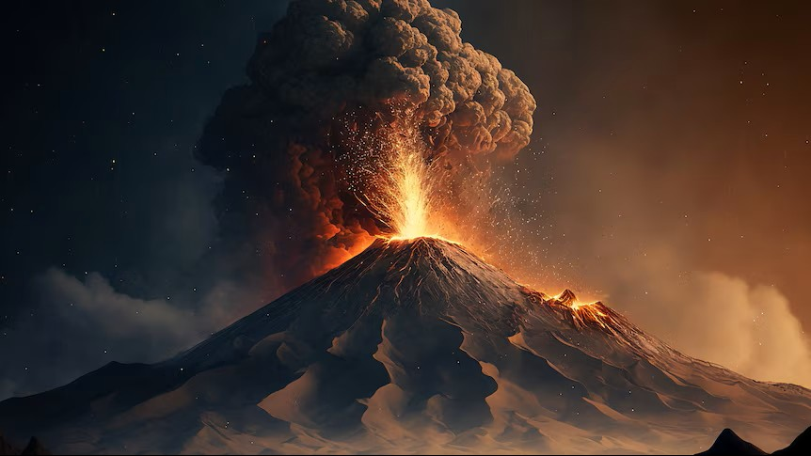
DISASTER MANAGEMENT
25008
Smart Solution for tough times

Slide 2
IDEA TITLE
Why disaster management ?
To protect lives, properties & resources
02
How to manage disaster ?
Early warning,
Public awareness &
Resource management
03
What is disaster management ?
Planning,response & recovery to minimize impact of a disaster
01

Slide 3
TECHNICAL APPROACH
FRONT END
HTML, CSS
BACK END
JAVASCRIPT, MYSQL

Slide 4
POTENTIAL CHALLENGES AND RISKS
AWARERNESS
MISINFORMATION
FUNDING
ENGAGEMENT

Slide 5
POTENTIAL BENEFITS
SAVING LIFE
LESS ECONOMIC LOSS
FASTER RECOVERY

Slide 6
RESEARCH AND REFRENCES
National Disaster Management Authority (NDMA), India – Guidelines and Reports.
International Federation of Red Cross and Red Crescent Societies (IFRC) – Disaster Response Framework.
World Health Organization (WHO) – Emergency Preparedness and Response.
Down To Earth Magazine – Disaster-related case studies and statistics.
Down To Earth Magazine – Disaster-related case studies and statistics

Slide 7
TEAM MEMBERS
TEAM ID : IH62825065
TEAM LEADER > SEJAR MAURYA (CU23220090)
MEMBER 1 > KHUSHAL (CU23250498)
MEMBER 2 > MANSI SINGH (CU23250070)
MEMBER 3 > MOHD.ZUBAIR (CU23220151)
MEMBER 4 > ADITYA SAINI (CU25240004)
MEMBER 5 > IZHAR ALI (CU23220165)

Slide 8
THANK YOU

